Slide 2
WEATHER FORECAST AND DISASTER ALARM IN HILLY AREAS
Presented by:
1.Gaurav Porwal
2.Anirudh Kushwah
3.Kumar Baibhav
4.Garvit Pant
Project Guide: Dr. JAGDISH CHANDRA PATNI

Slide 3
Team Members & Role
1.Gaurav Porwal: Developer
2.Anirudh Kushwah: Research and Evaluation
3.Kumar Baibhav: UI/UX Designer
4.Garvit Pant: Testing and Deployment

Slide 4

Introduction
India is at risk of numerous natural disasters due to its distinctive geo-climatic condition as a result of its geographical location.
The country has been hit roughly by eight natural calamities annually and there has been about five times increase in frequency of natural disasters within the past 3 decades.
This results in losing thousands of human lives every year, excluding heavy damage on property, animal life, etc., due to natural disasters.
In this project our aim to analyze weather conditions and history of data collected so far on disasters in hills to warn about any disaster that may happen.

Slide 5
Motivation
According to the International Panel for Climate Change, the rainfall intensity, duration and frequency are going to increase in the future, which will result in more disasters in hills.
Going through the news of disaster in hills and loss of countless human live makes us think about the suffering of the people living there and the people who got caught in these disasters.
In such areas not only the local residents, but tourists are also affected as they are not aware about the nature of disasters and get caught in it.
Lack of awareness results in loss of lives which can be saved just by alarming people about the weather situations and its dangers.

Slide 6
Problem Statement
We aim to perform disaster prediction on certain places in hills because disasters are more likely to happen in hilly areas as the weather changes.
We will analyze the weather and disaster data generated by reputed database and alarm people about the danger.
We need to have a clear way of calling API and parse the received Weather Forecast JSON data into readable form. After parsing the data, we need to extract the weather forecast data, analyse and display the result.

Slide 7
Objectives
It also helps in understanding the nature of floods, by this we can take proper measures as to be safe from the floods.
It can lead to more accurate tools for extracting disaster and weather behaviors and provides means for rescue operations before disasters hits hence assuring no human lives are lost.
To analyze the weather readings.
To determine the weather conditions by using the analyzed readings.
To display and read the weather conditions and confirm it with the existing data on disasters.
To classify the data into danger of floods and safe.

Slide 8
Methodology
The principle of the proposed system is as follows:
First the live weather data will be fetched by the API of the place entered by user by using KMP algorithm and display it, the data then will be analyzed, then it will be compared with our researched data(past disaster readings), then we will analyze the final data and alarm about any disasters that may happen.

Slide 9
Experimental Setup
Hardware Configuration:
Processor Intel Pentium Dual Core and Above
Memory: 512 MB RAM and Above
Clock Speed: 1.72 GHz and Above
Hard Disk Capacity: 80GB
Software Configuration:
Operating System: Ubuntu, Fedora Linux, Windows, Mac
Language: Java
Complier: Java Compiler (Java Virtual Machine)
Other tools and utilities: IntelliJ,API, many.jar files

Slide 10
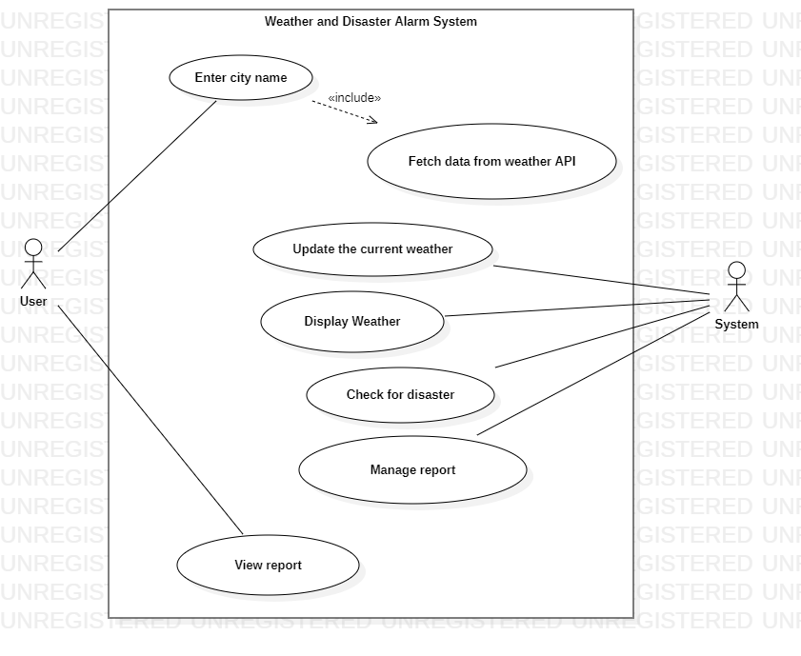
Use-Case Diagram

Slide 11
Conclusion
Weather forecasting is a complex and challenging science that depends on the efficient interplay of weather observation, data analysis by meteorologists and computers, and rapid communication systems.
Meteorologists have achieved a very respectable level of skill for shortrange weather forecasting.
Further improvement is expected with denser surface and upper air observational networks, more precise numerical models of the atmosphere, larger and faster computers and more are to be realized.
However, continued international cooperation is essential, for the atmosphere is a continuous fluid that knows no political boundaries.

Slide 12
References & GIT link
References:
Flood Disaster in Mountain Environment: A Study of Himachal Pradesh, India Vishwa B. S. Chandel, Simrit Kahlon, Karanjot Kaur Brar: Managing Our Resources Perspectives and Planning: https://www.researchgate.net/publication/303436834_Flood_Disaster_in_Mountain_Environment_A_Study_of_Himachal_Pradesh_India.
Managing the Risks of Extreme Events and Disasters to Advance Climate Change Adaptation Special Report of the Intergovernmental Panel on Climate Change: https://www.ipcc.ch/site/assets/uploads/2018/03/SREX_Full_Report-1.pdf.
Geological investigations in Rudraprayag district with special reference to mass instability: https://dmmc.uk.gov.in/files/pdf/Rudraprayag_final.pdf.
Exploring the nature and various forms of the impact of climate change on flora, fauna and local communalities in Uttarkashi, Pithoragarh and Bageswhar districts of Uttarakhand: https://dmmc.uk.gov.in/files/Impacts_of_Climate_Change.pdf
Git link:
https://github.com/GAURAVPORWAL005/Weather_forecast_and_disaster_alarm_in_hilly_areas./tree/master/src/com/company.

